Slide 1

Aslamualikum Everyone!

Slide 2

PHDDSF23M001 Adeela Tariq
MSDSF23M025 Syed Anas Hashmi

Slide 3
What’s in it for you
What is AWS?
Why Amazon Redshift?
What is Amazon Redshift?
Advantages of Amazon Redshift
Architecture of Amazon Redshift
Additional Concepts of Amazon Redshift
Limitation of Amazon Redshift
Companies using Amazon Redshift
Demo

Slide 4




What is AWS
Amazon Web Services is a secure cloud service platform from Amazon
AWS services can be used to create and deploy any application in the cloud
It provides services over the internet
With AWS, you pay only for what you use

Slide 5
Why Amazon Redshift
Cons of Traditional DWH Services:
Time Consuming
Maintenance Costs outweigh the benefits
Loss of information

Slide 6

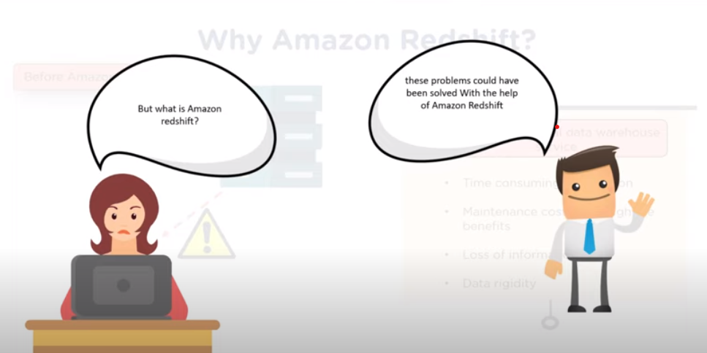
What is REDSHIFT
Amazon Redshift is cloud-based service or data warehouse service that is used for collecting and storing data.

Slide 7
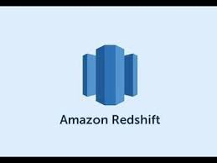
What is Amazon REDSHIFT
Enables user to analyse the data using BI tools and simplifies the process of handling large scale data sets.
Petabyte-scale data warehousing service in the cloud

Slide 8

What is Amazon REDSHIFT
Columnar data storage
Massive Parallel Processing
Designed for OLAP
Use SQL queries for data analysis

Slide 9
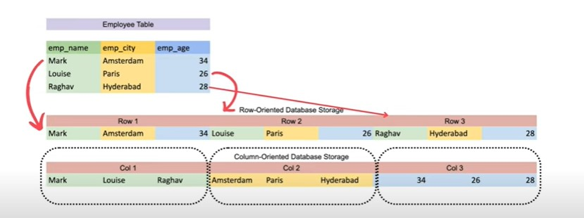
Columnar Data Storage
Data stored in column wise fashion
Columnar data stored in blocks (1 MB)
Efficient read when few columns are required
Better compression at column level

Slide 10
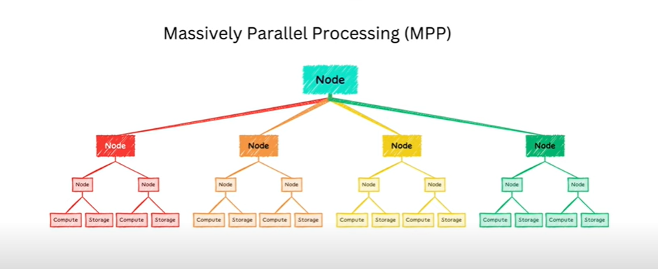
Massively Parallel Processing
Divide task into small similar tasks
Individual teams work in silo to complete the task
Director collate the tasks back into one

Slide 11
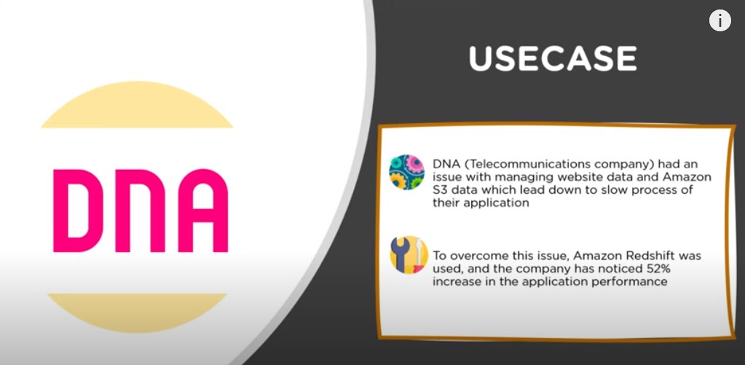

Slide 12
Amazon Redshift Architecture
Notes:
12

Slide 13
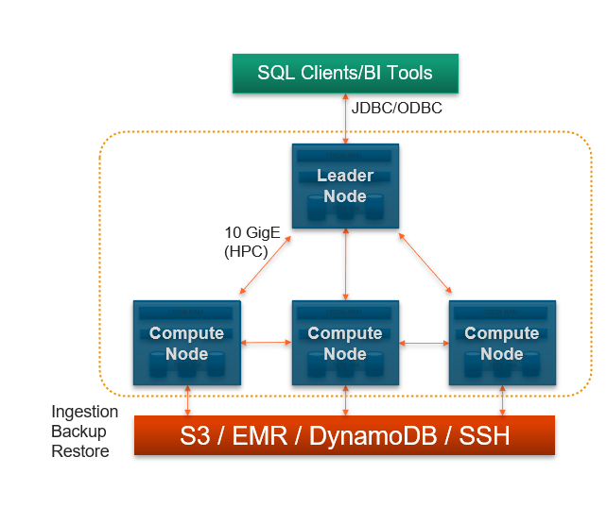
Architecture
Leader Node
SQL endpoint
Stores metadata
Coordinates parallel SQL processing

Slide 14
Architecture
Compute Nodes
Local, columnar storage
Executes queries in parallel
Load, backup, restore

Slide 15
Compute & Leader Node Components

Slide 16
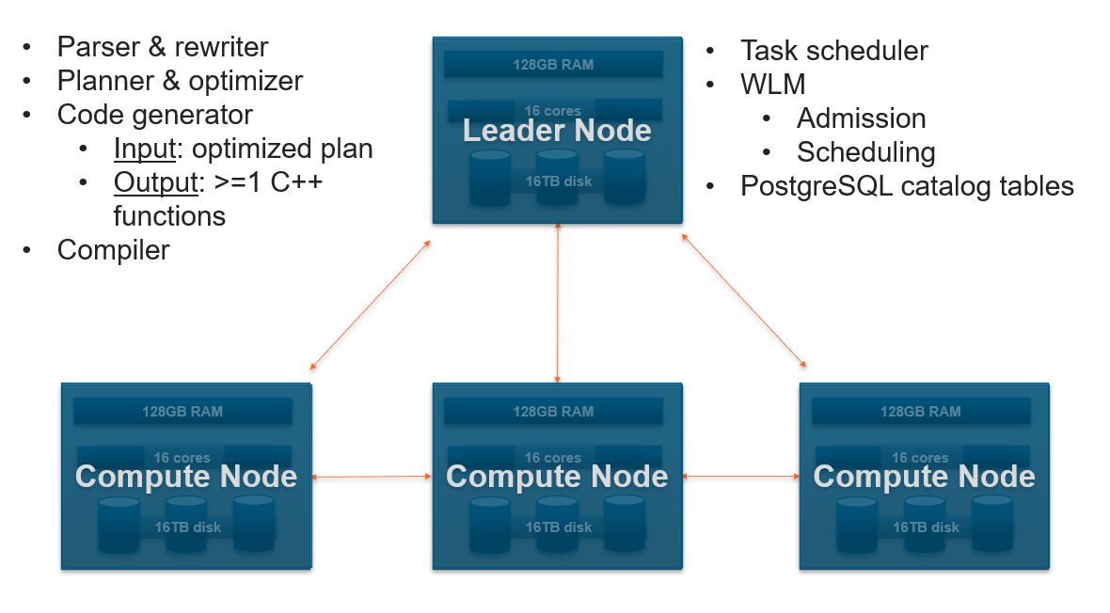

Slide 17
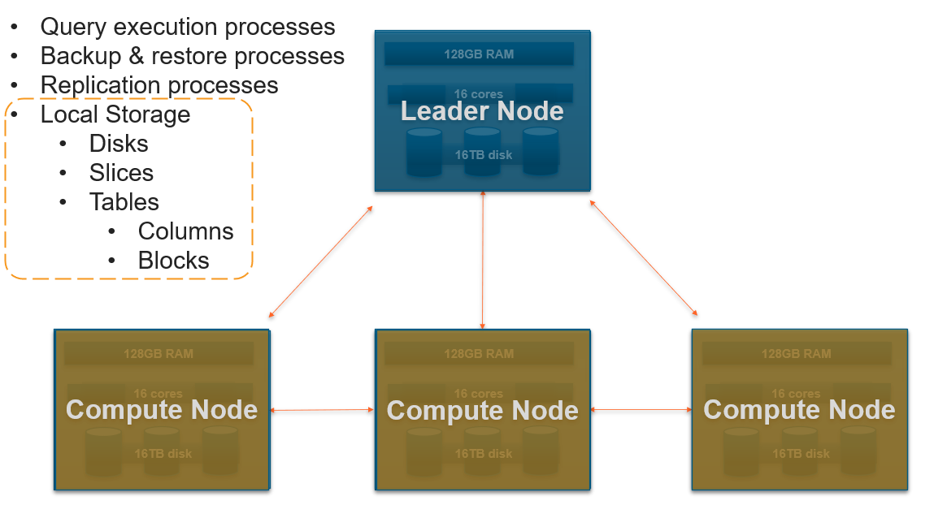

Slide 18

DID you know?
Redshift Costs less to operate than any other cloud data warehouse
Performance matters, it is fastest data warehouse

Slide 19
Advantages of amazon redshift

Slide 20
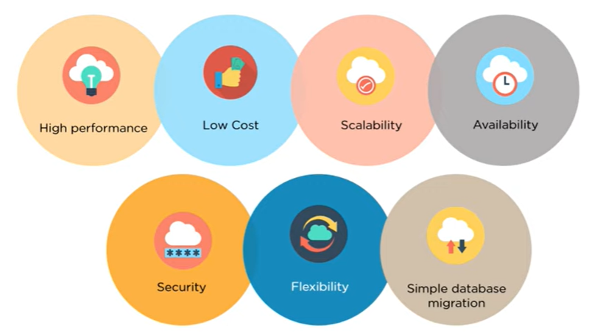

Slide 21
Data Distribution System
Redshift distributes data across compute nodes using:
Key-based Method
Round-Robin Method
All Distribution Method

Slide 22
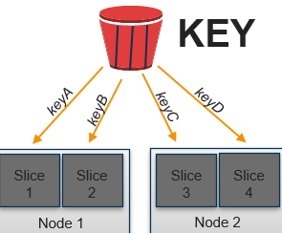
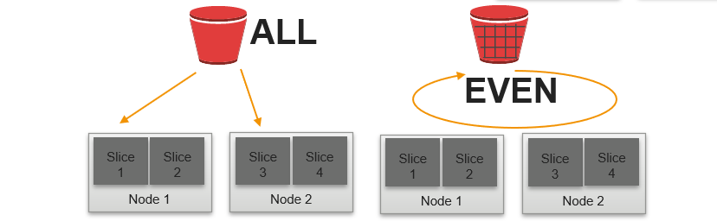
Data Distribution System
Distribution style is a table property which dictates how that table’s data is distributed throughout the cluster:
KEY: Value is hashed, same value goes to same location (slice)
ALL: Full table data goes to slice of every node
EVEN: Round robin

Slide 23

Data distribution
Goals:
Distribute data evenly for parallel processing
Minimize data movement during query processing

Slide 24
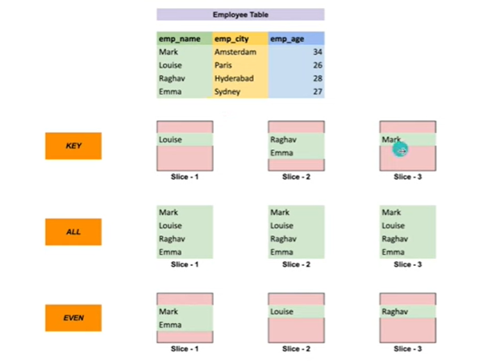

Slide 25
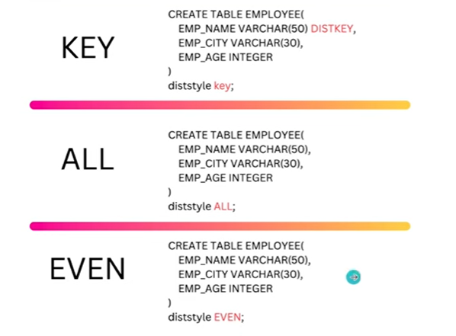
Queries

Slide 26
Security Features
Amazon Redshift offers a range of security features:
Encryption
Role Base Access Control
Compliance and Auditing
Dynamic Data Masking
Notes:
26

Slide 27
Encryption
It refers to protection of data while transit and at rest.
Use server-side encryption – Request Amazon Redshift to encrypt your data before saving it on disks in its data centers.
Use client-side encryption – You can encrypt data client-side and upload the encrypted data to Amazon Redshift. In this case, you manage the encryption process, the encryption keys, and related tools.

Slide 28
Role Base Access Control
Create a role by using different commands
To create a role, use the CREATE ROLE command.
To delete a role, use the DROP ROLE command
To grant system permissions to a role, use the GRANT command.
Assign the controls by defining the role type. (User, Super User and Group)

Slide 29
Compliance and Auditing
Amazon Redshift's support for compliance standards and auditing capabilities.
Compliance Certifications: List compliance certifications and attestations (e.g., SOC 1/2/3, PCI DSS, HIPAA) that Redshift complies with.
Redshift provides audit logging capabilities for monitoring and tracking database activity, including user actions and changes to database objects.

Slide 30
Dynamic Data Masking
Redshift supports dynamic data masking to conceal sensitive data based on user permissions
Dynamic data masking is complementary to other SQL Server security features (auditing, encryption, row level security, etc.) and it's highly recommended to use it with them in order to better protect the sensitive data in the database.

Slide 31
Data Backup
Redshift automatically takes snapshots of the cluster and backs up data to Amazon S3 at regular intervals.
Snapshots are point-in-time backups of a cluster.
By default Amazon Redshift takes a snapshot about every eight hours
Shortest amount of time in between automated snapshot creation is 15 minutes
Custom Scheduling

Slide 32

Amazon redshift customers

Slide 33
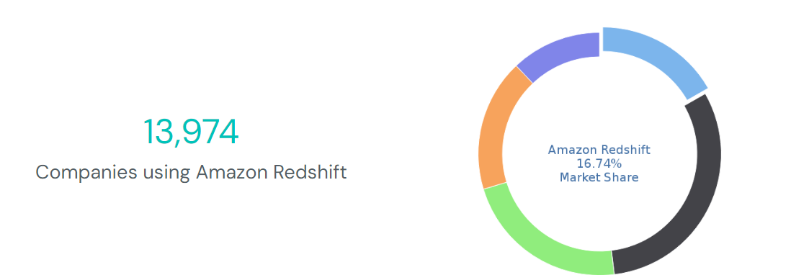
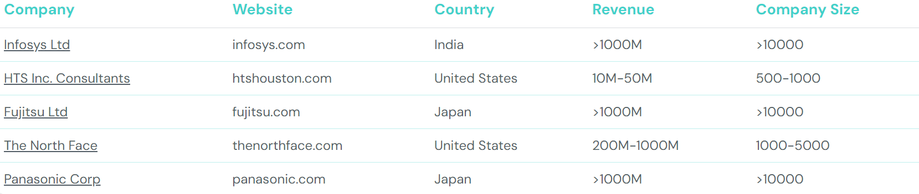

Slide 34
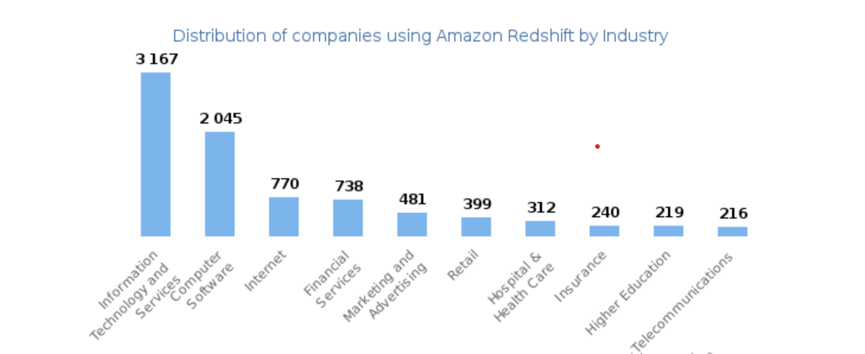
Amazon Redshift Customers
Looking at Amazon Redshift customers by industry, we find that Information Technology and Services (22%), Computer Software (14%), Internet (5%) and Financial Services (5%) are the largest segments.
60% of Amazon Redshift customers are in United States, 6% are in United Kingdom and 6% are in India.

Slide 35
Redshift Pricing Model
Flexible pricing scheme
The price starts at $0.25 per hour for a terabyte of data
AWS Redshift offers three types of nodes.
RA3 nodes with managed storage(1.08 per hour)
DC2 Nodes (Local SSD Storage)
DS2 nodes (for large amount of data)

Slide 36
Use Case: Sound Cloud
Data Collection: User activity data is collected in real-time using Amazon Kinesis.
Data Streaming: Kinesis Data Firehose streams the data into an S3 bucket.
ETL Processing: AWS Glue transforms the raw data and loads it into Amazon Redshift.
Data Analysis: Analysts use SQL queries in Redshift to analyze the data, generating insights on user behavior and track performance.
Reporting: BI tools like Tableau are used to create dashboards and reports from the data in Redshift.

Slide 37
Limitations
Master Node
A Master Node plays a critical role in the Redshift architecture. All clients only interact with the master node; therefore, a non-redundant master node creates a single point of failure for the environment.
Not a Multi-Cloud Solution
Amazon Redshift is only available on AWS

Slide 38
Limitations
Parallel Uploads:
Redshift does not support all databases for parallel upload. Amazon S3, EMR, and DynamoDB are supported by Redshift for parallel uploads using ultra-fast MPP. For other sources, separate scripts have to be used to upload data. This can be a very slow process.
For Installation:
https://www.youtube.com/watch?v=8b58xGDHIog

Slide 39

ELASTICSEARCH

Slide 40
OBJECTIVES
History of ElasticSearch
What is ElasticSearch
Goals of ElasticSearch
How to install it?
01
02
03
04
Benefits of ElasticSearch
UseCase
Comparison of Amazon Redshift vs ElasticSearch
05
06

Slide 41
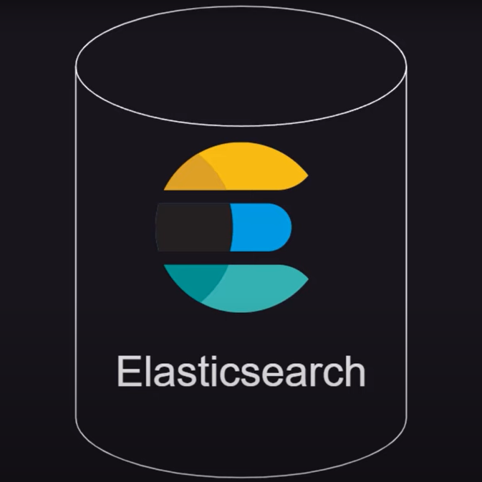
History of ElasticSearch

Slide 42

ElasticStack is the open source community which worked on some components which are following:
ElasticSearch
Kibana :
LogStash
Beats
X-Pack

Slide 43




ElasticSearch
ElasticSearch is built on top of Apache lucene
ElasticSearch is an open source analytics and full text search engine
ElasticSearch is horizontally scalable, the database can run in multiple servers(nodes)
ElasticSearch stores data in a data structure which is called inverted index.

Slide 44
Kibana: Dashboard for analysing and visualizing
Logstash: Process logs from application and send them to elastic search but it has been evolved now, It is a free and open-server side data processing pipeline that ingests data from a multitude of sources, trnasform it and then sends it to your favorite "stash"(Kafka/ElasticSearch)
ElasticSearch Sql:
Sql API, Sql-query result
Translated API:SQL query ->Query DSL(Domain Specific Language)

Slide 45
X-PACK
X-Pack: Adds additional features to the Elastic Search Kibana
Security: Adds authentication and authorization
Monitor: The performance of Elastic Search and get notified
Enables: machine learning on Kibana and Elastic Search
Graph: Analyse relationship/relevance in data useful for recommendations. It exposes an API that we can integrate in our applications

Slide 46

BEATS
A collection of data shippers. They are light weight agents which sends data from hundereds or thousands of machines and systems to Logstash or ElasticSearch
Different kinds of beats do different tasks
NOTE: This is written in java

Slide 47
Goals of ElasticSearch
Real-Time Search and Analytics: Elasticsearch is designed to provide fast and scalable search and analytics capabilities, enabling real-time insights into data.
Distributed Nature: It is built to be distributed, allowing it to scale horizontally by adding more nodes to the cluster.
High Availability: Elasticsearch ensures data reliability and availability through replication and automatic recovery.
Flexible Schema: It supports dynamic mapping and schema-free JSON documents, making it easy to index and search data without predefined schemas.
RESTful API: Elasticsearch uses a RESTful API, making it easy to integrate with various programming languages and tools.
Full-Text Search: It offers powerful full-text search capabilities, leveraging the underlying Lucene library.

Slide 48

HOW TO INSTALL?

Slide 49
Architecture of ElasticSearch
Cluster: A cluster is a collection of one or more nodes (servers) that together hold the entire data and provide federated indexing and search capabilities.
Node: A single server that is part of a cluster, storing data and participating in the cluster’s indexing and search operations.
Index: An index is a collection of documents that have somewhat similar characteristics. Each index is identified by a unique name, which is used to refer to the index when performing indexing, search, update, and delete operations.

Slide 50
Architecture
Document: A basic unit of information that can be indexed. Each document is a JSON object and is stored in an index.
Shard: Each index can be split into multiple shards. A shard is a single instance of Lucene and it allows Elasticsearch to distribute data across multiple nodes in a cluster.
Replica: A replica is a copy of a shard. Replicas provide high availability and fault tolerance. By default, Elasticsearch creates one replica for each primary shard.

Slide 51
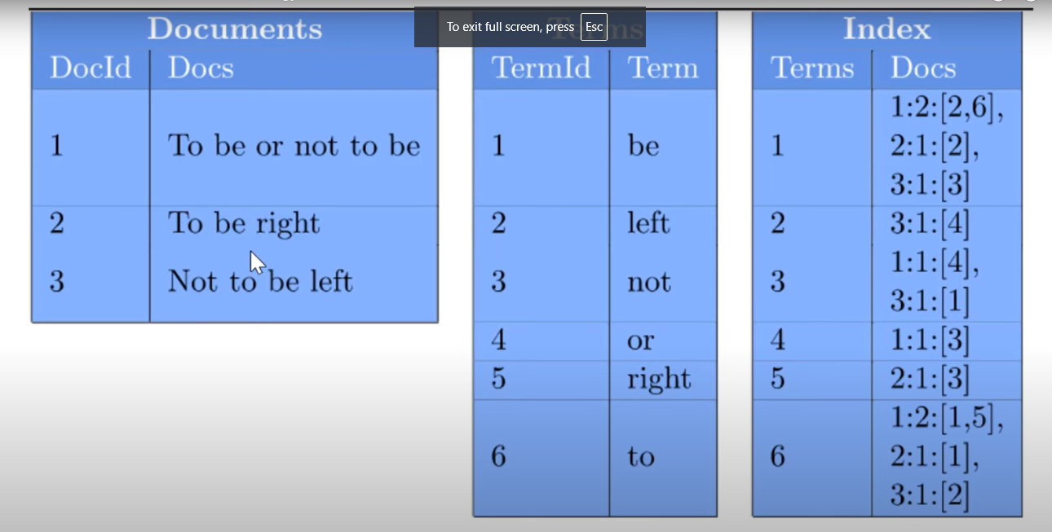
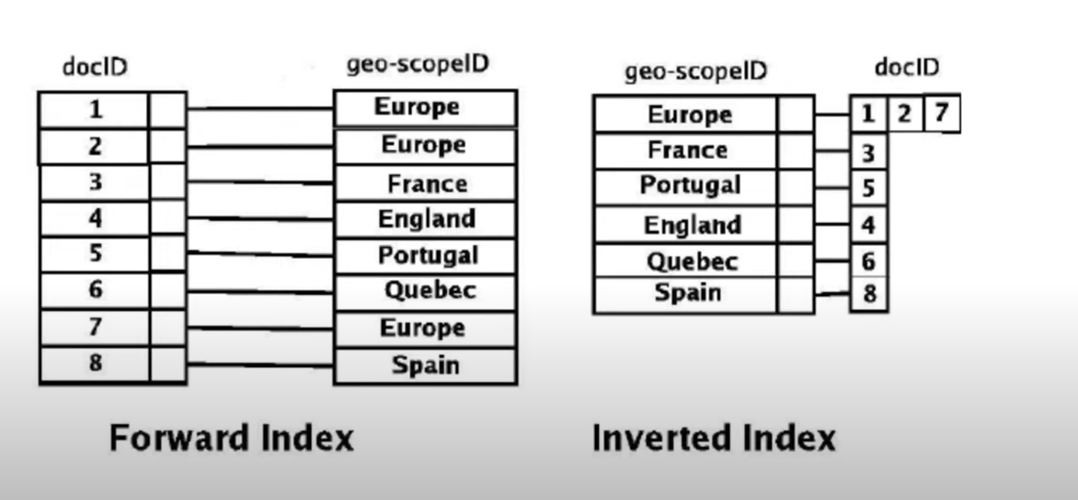
Inverted Index

Slide 52
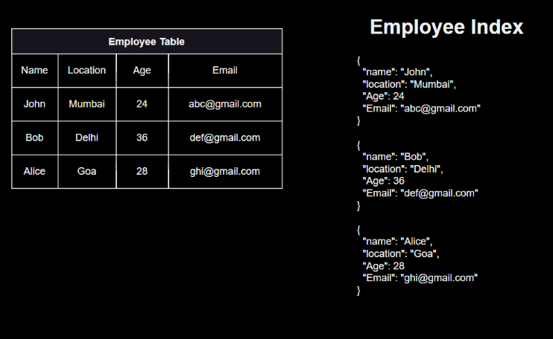
Analogy to RDBMS

Slide 53
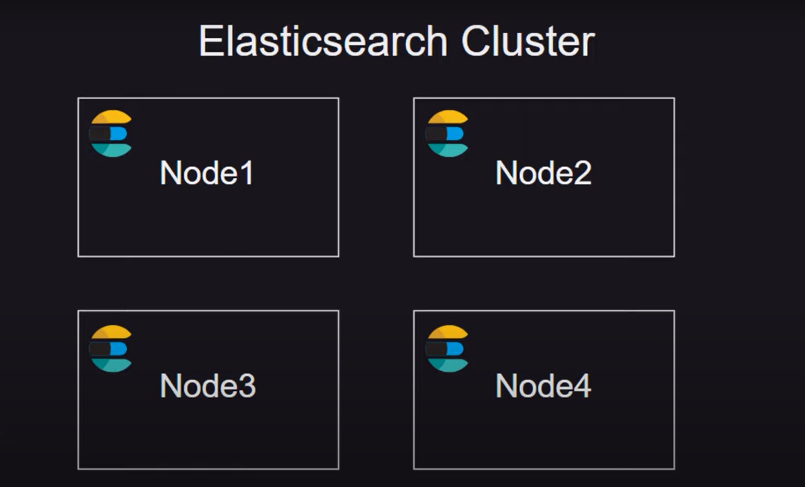
Working of ElasticSearch

Slide 54
Explanation of the Diagram
Cluster:
The entire Elasticsearch setup is known as a cluster. It consists of multiple nodes working together to provide indexing and search capabilities.
Node:
Each node is a single instance of Elasticsearch, which stores data and participates in the cluster’s operations.
Nodes can be added or removed to scale the cluster horizontally.

Slide 55
Shard:
Shards are the basic units of data storage in Elasticsearch. Each index is divided into multiple shards.
Shards can be of two types: primary shards and replica shards.
Primary Shard:
The primary shard contains the original data. Each document in an index is stored in one of the primary shards.
Replica Shard:
Replica shards are copies of primary shards. They provide redundancy and increase search performance.
If a primary shard fails, a replica shard is promoted to primary to ensure data availability.

Slide 56
Storage
Document-Oriented Storage
Document-oriented databases: Store data as documents, typically in formats such as JSON or BSON. Each document is a self-contained unit of data that can contain nested structures, arrays, and key-value pairs. In Elasticsearch, these documents are indexed for fast retrieval and stored in a distributed manner across the cluster.
Characteristics of Document-Oriented Storage in Elasticsearch
Schema-Free: Elasticsearch allows for flexible and dynamic schemas. You can index documents without predefining a schema, and fields can be added as needed.

Slide 57
Storage
JSON Documents: Data is stored in the form of JSON documents, making it easy to handle complex nested structures.
Full-Text Search: Elasticsearch leverages Apache Lucene to provide powerful full-text search capabilities on the contents of the documents.
Rich Query DSL: Elasticsearch provides a domain-specific language for querying documents, supporting complex queries, aggregations, and filters.

Slide 58




Key Features of Elasticsearch as a Document Storage
Indexing: Each document is indexed, allowing for efficient retrieval based on its contents.
Search Capabilities: Elasticsearch provides robust search capabilities, including full-text search, relevance scoring, and complex querying.
Scalability: It can handle large volumes of data by distributing documents across multiple nodes and shards.
Aggregations: Elasticsearch supports powerful aggregations for summarizing and analyzing data.
Dynamic Mapping: New fields can be added dynamically as documents are indexed, without requiring predefined schemas.

Slide 59
REAL-TIME USE CASE
Elasticsearch Case Study: Wikipedia Uses Elasticsearch
Wikipedia faced challenges with search relevancy, scalability, and multilingual support. To address these, Wikimedia Foundation implemented Elasticsearch, enhancing search accuracy and efficiency through its full-text search capabilities and distributed nature. This transition allowed Wikipedia to handle high traffic volumes, improve user satisfaction with faster, more relevant results, and streamline operations. Elasticsearch’s multilingual support further bolstered search capabilities across different languages, significantly improving the overall user experience.

Slide 60
Comparison of Amazon Redshift vs ElasticSearch
Feature/Aspect | Elasticsearch | Amazon Redshift
Type | Document-oriented, search and analytics engine | Columnar data warehouse
Primary Use Case | Full-text search, real-time analytics, log/event data analysis | Large-scale data warehousing, complex analytical queries
Data Model | JSON documents | Relational, columnar storage
Schema | Schema-free, flexible, and dynamic | Predefined schemas
Query Language | Elasticsearch Query DSL | SQL
Storage Format | Document-oriented | Columnar
Scalability | Horizontal scaling with distributed architecture | Vertical scaling by resizing clusters

Slide 61
Comparison of Amazon Redshift vs ElasticSearch
Feature/Aspect | Elasticsearch | Amazon Redshift
Indexing and Search | Real-time indexing and search, full-text search capabilities | Batch processing, optimized for read-heavy queries
Aggregation | Rich aggregation capabilities | Advanced SQL aggregation and analytical functions
Pricing Model | Open-source with commercial plugins (Elastic Cloud) | Pay-as-you-go based on cluster size and usage
Availability | High availability with sharding and replication | High availability with managed clusters

Slide 62

Any Question!

Slide 63

Thank You For Your Particaption

